Slide 1

Project Title:
SECURING DATA WITH BLOCKCHAIN AND AI.
DEPARTMENT OF CSE – CYBER SECURITY.
Head Of the Department : Dr SSN Anjaneyulu Sir.
Project Guide : Shaik Subhani Sir .
Chitturi Sai Ganesh Kumar - 20BJ1A4603.
Kagitha Manohar - 20BJ1A4604.
Rayapudi Lahari - 20BJ1A4609.
Shaik Ismail - 20BJ1A4611.

Slide 2

Securing Data with Blockchain and Ai

Slide 3
INDEX
Abstraction
Introduction
Literature Survey
Existing System
Proposed system
Software and Hardware Requirements
Justification of Platform
Pow algorithm
Er-diagram representation.
Experimental Results
Conclusion
References

Slide 4
Abstract:
Problem: Data is fragmented across the internet, controlled by different parties who distrust each other. Authorizing and validating data usage is difficult, hindering the creation of "real big data" and powerful AI.
Solution: An architecture for secure data storage, computing, and sharing.
SecNet Components:
Blockchain-based data sharing: Ensures data ownership and enables trusted sharing for real big data creation.
AI-based secure computing platform: Creates intelligent security rules for a more secure cyberspace.
Trusted value-exchange mechanism: Provides economic rewards for data sharing, incentivizing participation and promoting AI performance.

Slide 5
Introduction:
Data Importance and Security Concerns: Data is crucial in the cyber world, but not all data can be public. Sensitive data like patient health information needs protection. Additionally, users often lack control over their data stored by service providers.
Proposed Solution: Private Data Centers (PDC) with Blockchain and AI: This approach aims to secure user data. It uses three techniques:
Project Focus: The project will implement these concepts using medical data sharing as an example.
Blockchain: Manages data sharing with access control. Users define who can access their data, and only authorized users can view it.
AI: Functions as a secure computing platform. It checks if a user has permission to access data before allowing access.
Rewards: Users who share data earn rewards, incentivizing data sharing and improving AI performance.

Slide 6
Literature Survey:
Data security in Cyber-Physical Systems (CPS):
Data Security Challenge: Data security is crucial for CPS and AI algorithms. Large amounts of data from various sources are needed, but this data also requires robust protection. Stronger AI can potentially enhance data security by identifying complex threats.
Efforts to Decouple Data and Applications: The passage discusses two approaches to improve data security in CPS:
Amber Architecture: This separates user data from web applications, granting users control over their information and enabling a search function.
OpenPDS (Open Personal Data Store): This acts as a secure virtual space for users to manage their data, isolating it from applications and offering a "SafeAnswer" mechanism to reduce data exposure during queries.

Slide 7
Blockchain for Secure Data Management: Blockchain technology emerges as a promising solution for CPS data security. It offers:
AI for Enhanced Security: AI can analyze vast amounts of data to identify patterns and make predictions, potentially improving data security in CPS. The passage highlights the need for large datasets to train robust AI models for better data protection.
Tamper-proof and Traceable Recording: Data records cannot be altered, ensuring data integrity and traceability.
Incentive Mechanisms: Blockchain can incentivize data sharing, promoting collaboration and potentially leading to more secure systems.

Slide 8
Existing system:
Ineffectiveness of Encryption: Traditional encryption methods might not be sufficient to fully secure data from attackers.
Lack of User Authorization Verification: Existing systems might not always verify user access permissions properly.
Hackers use various techniques to potentially crack encryption or exploit vulnerabilities in the system.This can lead to unauthorized individuals gaining access to sensitive data.
Disadvantages:
Vulnerability to Attacks: Encryption, a common protection method, can be broken by determined attackers, leads to data exposed.
Uncontrolled Access: Existing systems might not always check user permissions thoroughly, allowing unauthorized access to sensitive data.

Slide 9
Proposed system:
The proposed system enables Private Data Centers (PDC) with Blockchain and AI technique to provide security to user's data.
Blockchain-based data sharing with ownership guarantee, which enables trusted data sharing and generates hash code (unique). data sharing and generates hash code (unique).
Advantages :
Enhanced Data Ownership and Control:
Blockchain technology ensures users retain ownership of their data.
Users define who can access their data, granting granular control over access permissions.
Improved Data Security and Trust:
Blockchain provides a tamper-proof ledger, guaranteeingdata integrity and preventing unauthorized modifications.
Trust in the system is established through secure data sharing mechanisms.

Slide 10
SOFTWARE REQUIREMTS:
IDE: PyCharm
Front End: Html, CSS, JS
Back End: MySQL Server
Operating System: Window 7/Window 10
Programming Language: Python
HARDWARE REQUREMENTS:
Intel ® Core i3 CPU 3.0 GHz or above
4GMRAM
500GB Hard Disk Drive (HDD) + 24GB Solid State Drive(SSD)
Monitor
Processor: Intel Atom® Processor Z2520 1.2 GHz, or faster processor Storage: Between 850 MB and 1.2 GB, depending on the language version • RAM: Minimum of 512 MB, 2 GB is recommended • Hard Disk: 2GB of available hard-disk space for installation; extra free space is required during installation.
Developing Time Requirements
Runtime Requirements

Slide 11
Python: It's a general-purpose, versatile language with a clear syntax and easy-to-read code. It also offers automatic memory management and supports various programming styles.
Django: This high-level Python web framework is ideal for rapid development and clean design. It provides a foundation for building complex web applications without needing to write everything from scratch.
MySQL: This open-source relational database management system (RDBMS) is popular for its ease of use, speed, and compatibility with various programming languages, including Python. It can handle large datasets efficiently.
Justification of Platform:
Python
Django
mysql

Slide 12
Proof of Work (PoW) algorithm:
POW algorithm is a cryptographic consensus mechanism used in some blockchains to validate transactions and secure the network.
Mining Process: PoW involves complex puzzles solved by miners using computing power. This creates a secure and verifiable record of transactions on the Blockchain.
Tamper-proof Ledger: The difficulty of solving these puzzles makes it nearly impossible to alter past transactions on the Blockchain, protecting data integrity.
Network Decentralization: Anyone can participate in mining, which distributes the validation process and prevents a single entity from controlling the network. This strengthens overall security.

Slide 13
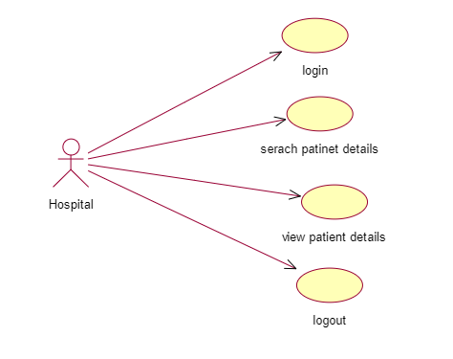
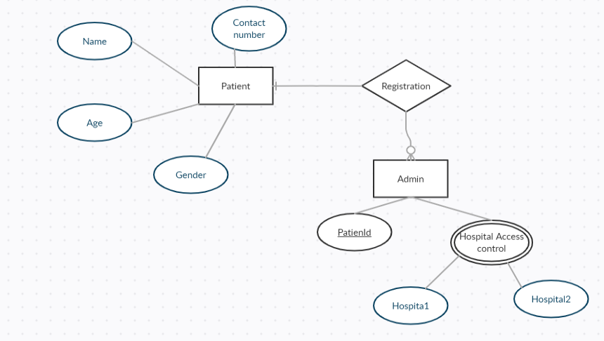
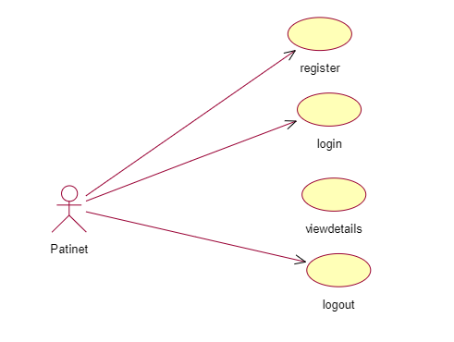
E-R diagram representation:

Slide 14
Experimental Results:
Deployment and Functionality:
Security and Transparency:
You can deploy the code on Django and run the server. The provided figures showcase the functionalities:
Patients can register, create profiles, and share data with specific hospitals.
Hospitals can log in, search for patients based on disease, and access data based on granted permissions.
Blockchain ensures data security and access control.
Only authorized hospitals can access patient data.
Patients can see a hash code (unique identifier) for their data and
their earned rewards for data access.

Slide 15
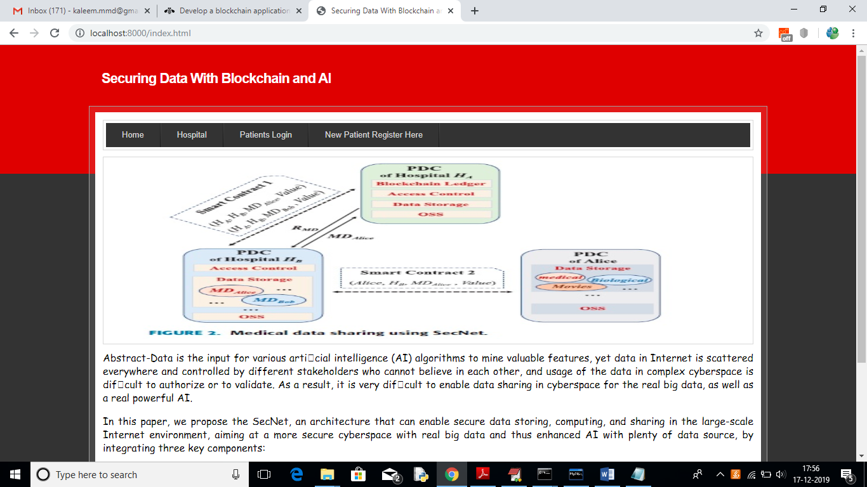
Deploy code on DJANOGO and start server and run in browser to get below screen

Slide 16
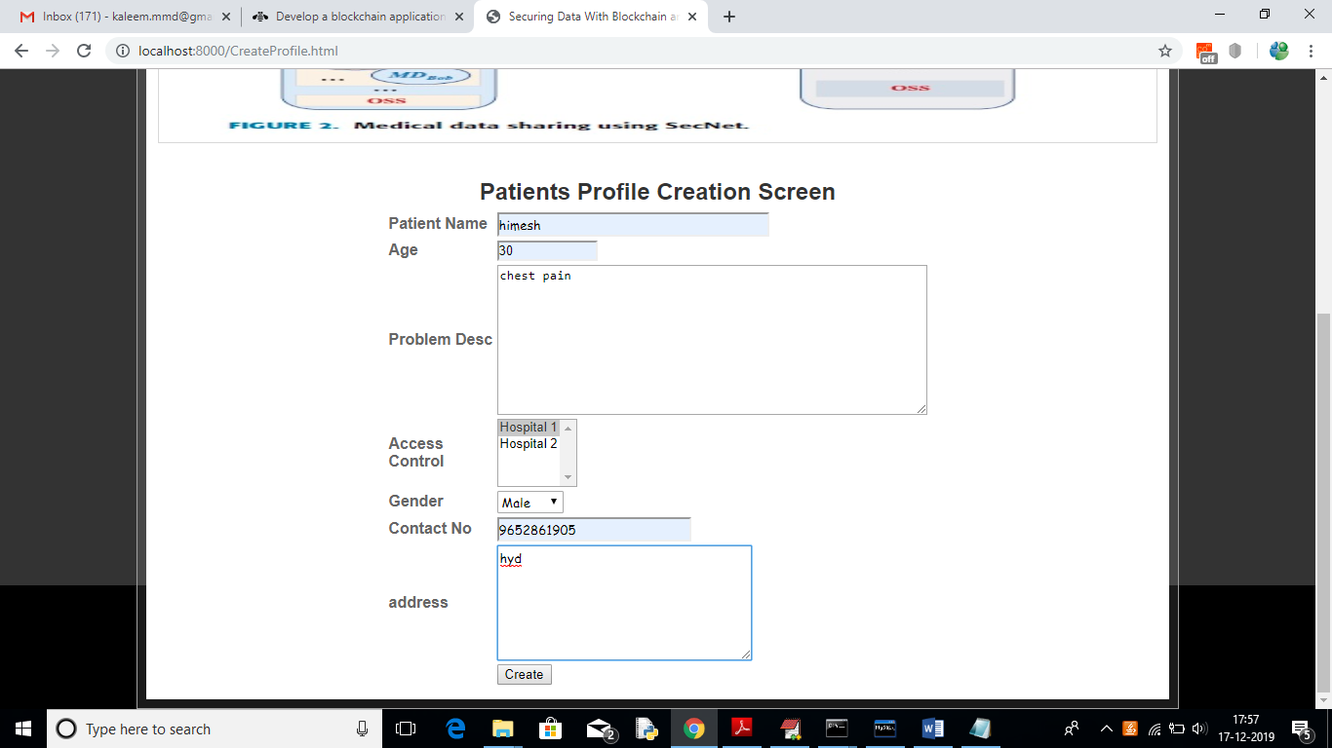

Slide 17
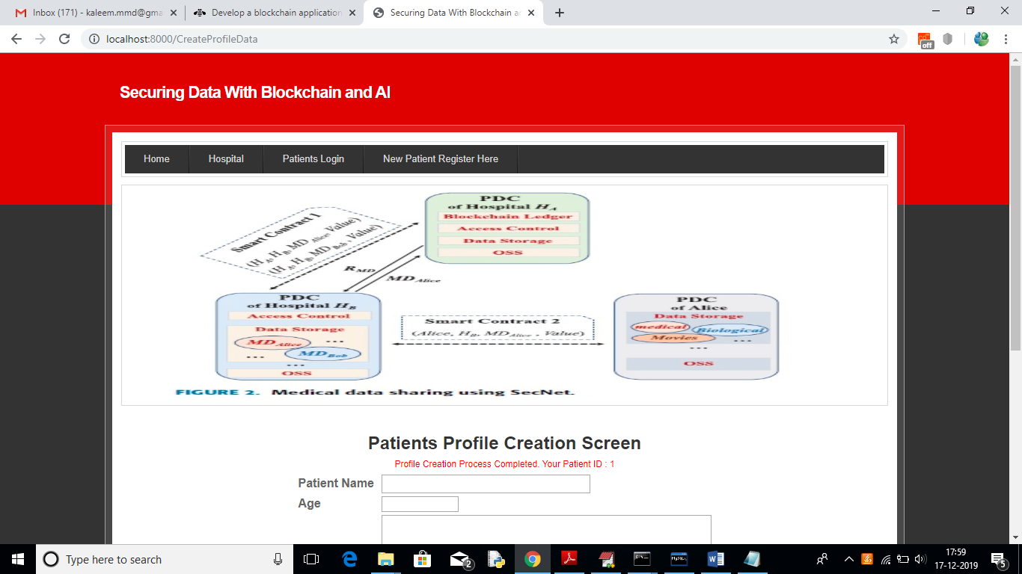

Slide 18
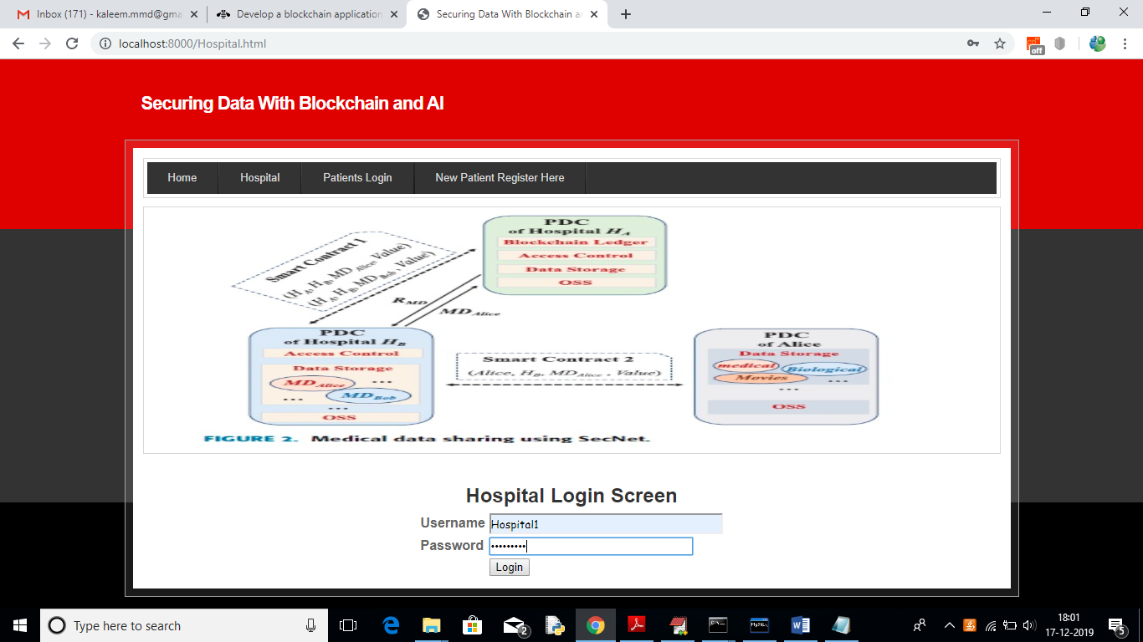

Slide 19
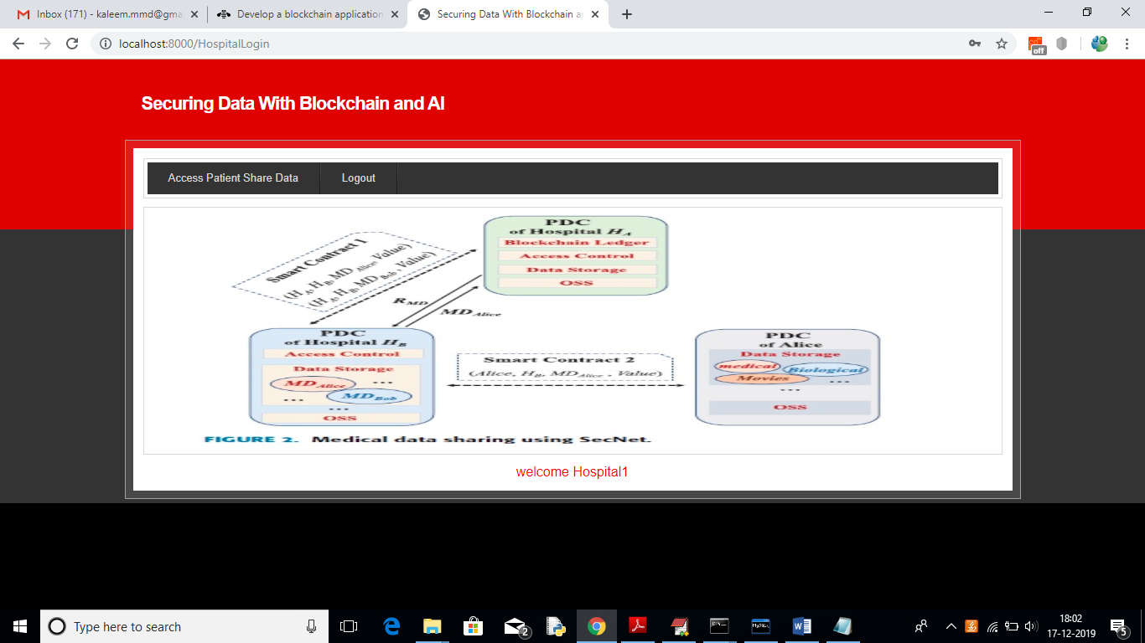

Slide 20
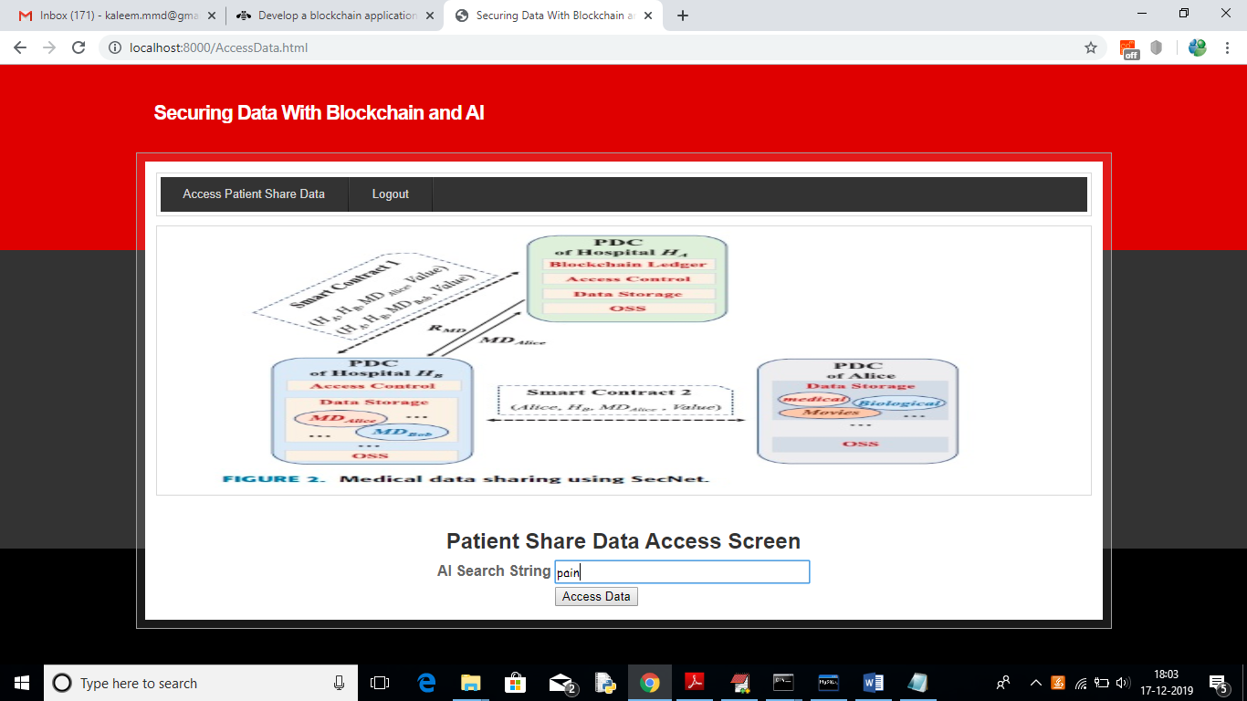

Slide 21
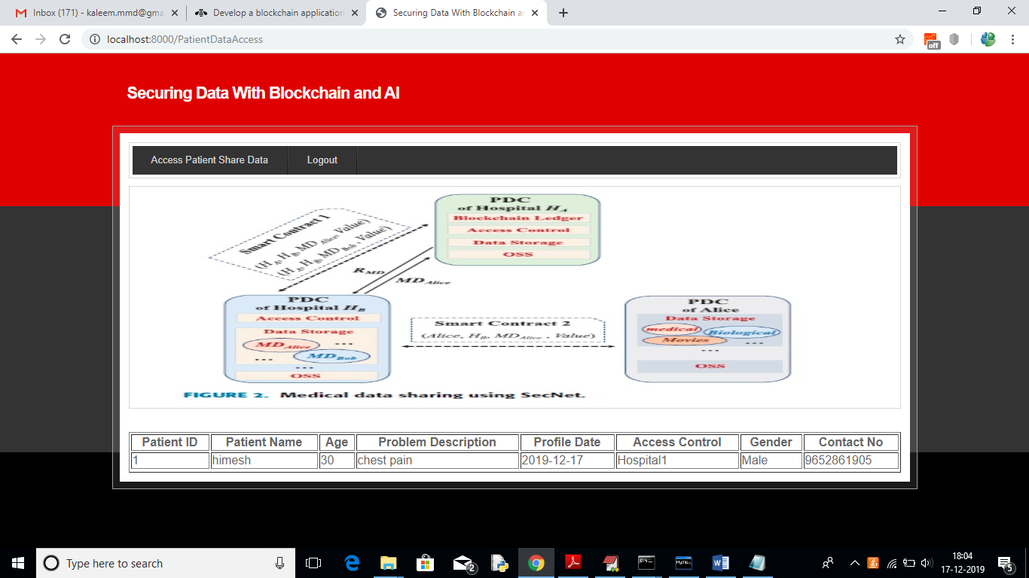

Slide 22


Slide 23


Slide 24
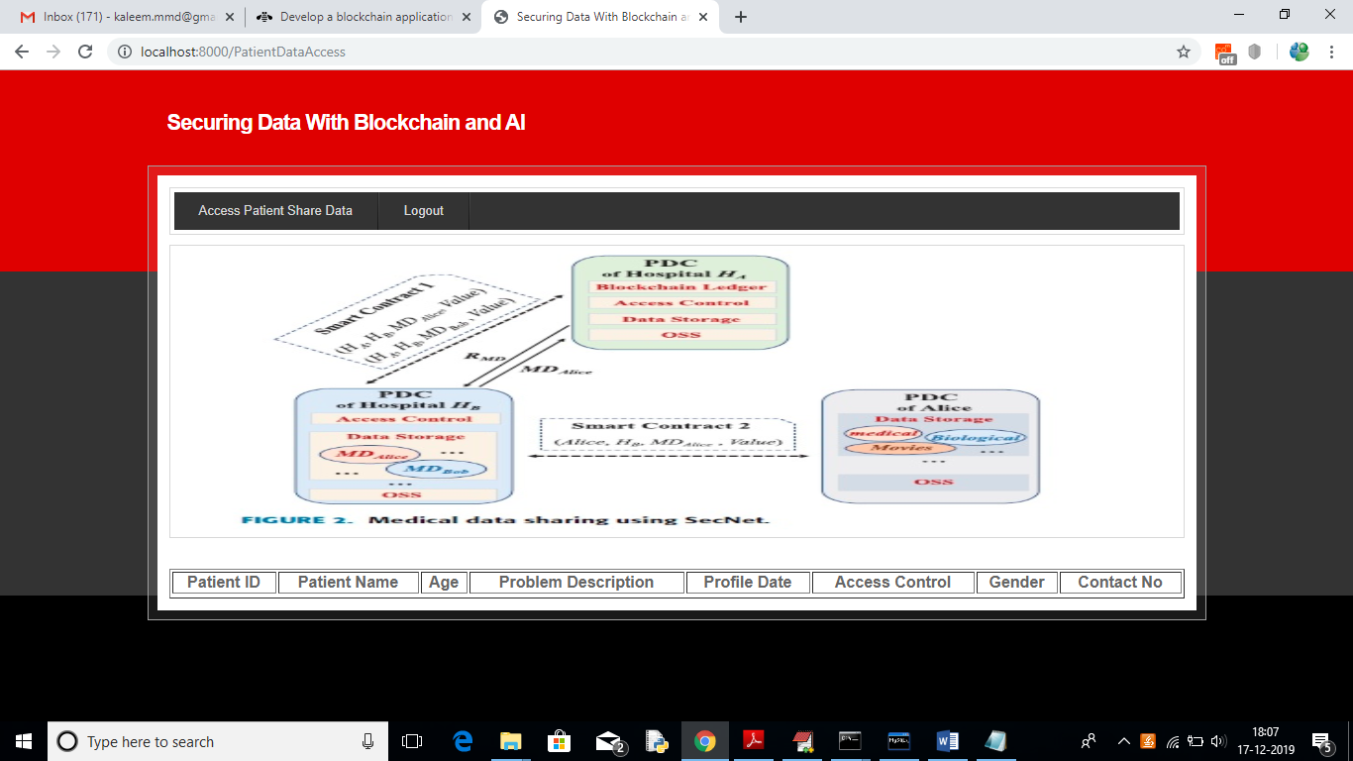

Slide 25


Slide 26
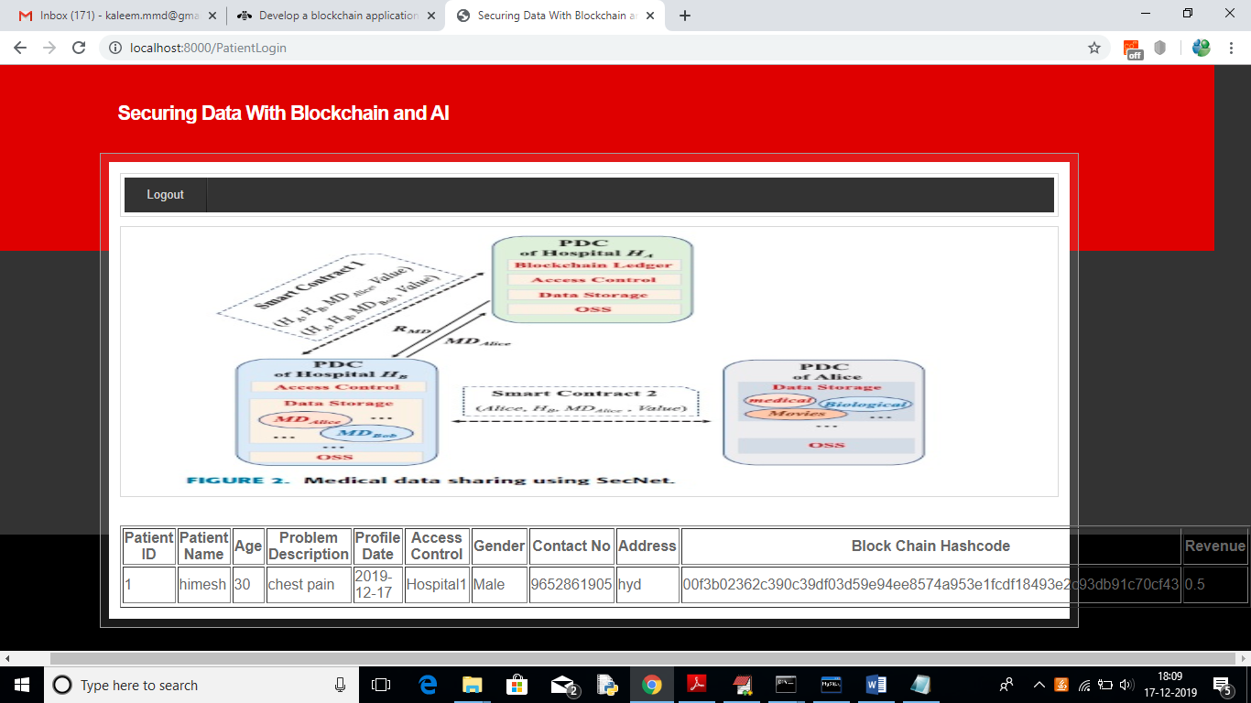

Slide 27
Combating Data Abuse and Empowering AI: SecNet aims to address data abuse and empower AI in untrusted environments. It focuses on secure data storage, sharing, and computation instead of just communication.
Core Technologies: SecNet leverages three key technologies:
Applications and Transparency: SecNet's use case is explored in healthcare, but its secure storage functionality can be applied in various scenarios. Patients can view a hash code (unique identifier) for their data and their data access rewards.
Conclusion:
Blockchain: Guarantees data ownership and access control.
AI-based secure computing platform: Analyzes access requests and ensures authorized data usage.
Blockchain-based incentive mechanism: Rewards users for sharing data, promoting data contribution and fostering a robust AI.

Slide 28
https://www.python.org/downloads
https://www.jetbrains.com/pycharm
https://www.djangoproject.com
https://www.tutorialspoint.com/python_blockchain/index.htm
https://www.tutorialspoint.com/artificial_intelligence_with_python/artificial_intelligence_with_python_heuristic_search.htm
https://www.w3schools.com/MySQL/default.asp
https://pynative.com/python-mysql-database-connection
https://www.javatpoint.com/blockchain-hash-function
References:

Slide 29
